Slide 1
Strings in Python
By Anirudh K M
Analyst
Mobius Knowledge Services

Slide 2
Non-scalar objects
One of the prime example of non-scalar objects is string(str).
String are written in either single or double quotes as follows.
‘abc’
“abc”
‘123’ → This is a string of characters, not integers.
‘3223.32’ → This isn’t float either.
Both these mean the same thing, its your wish to choose one, but stick yourselves to one of them for uniformity.

Slide 3
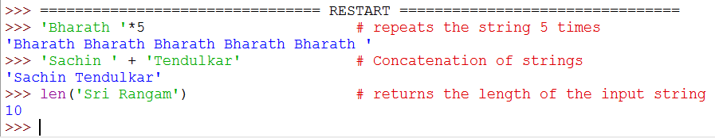
Operations on String
These are some of the basic operations that can be done on strings.

Slide 4
More operations on strings
We can use more string attributes by invoking them in the following ways.
string.attribute(args).
args – depends.
Few of the important attributes that are used are as follows:
format.
find.
index.

Slide 5
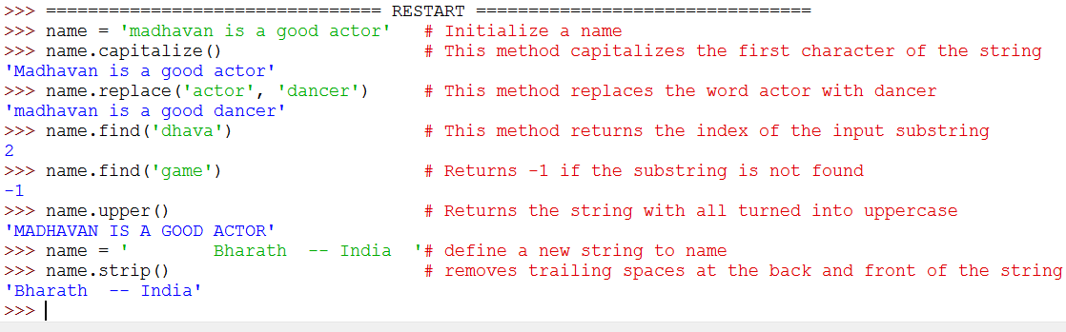
Illustration

Slide 6
Extracting parts of String
We can Extract parts of string by the following ways:
Indexing.
Slicing.
Indexing:
Let us consider a string, name = ‘will’
Lets say that this is how the characters of the string are stored in memory.
w | i | l | l

Slide 7
Indexing
Now we can get access to each element of the string with indexing.
With the below picture we get the understanding of indexing of strings.
Forward indexing | 0 | 1 | 2 | 3
String value | w | i | l | l
Backward Indexing | -4 | -3 | -2 | -1

Slide 8
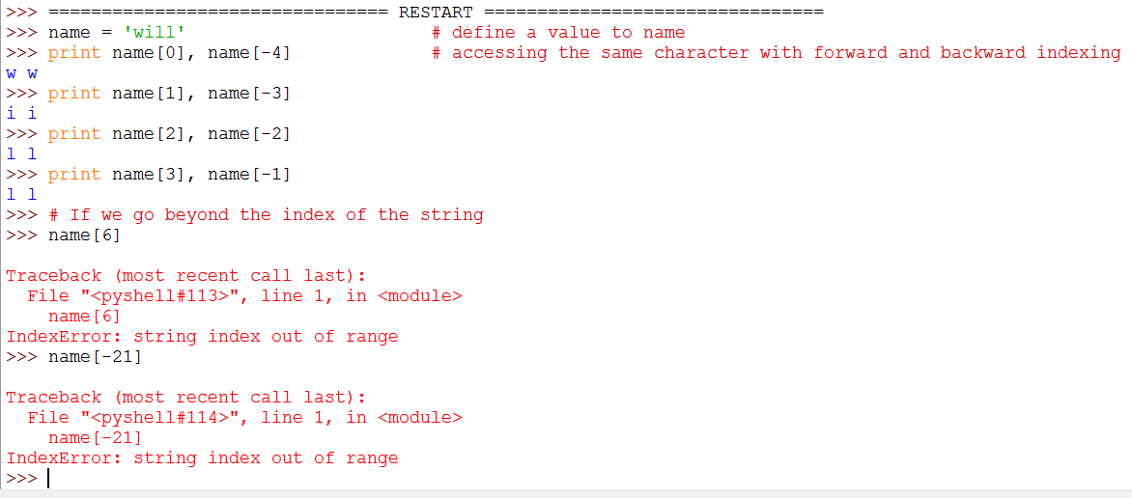
Indexing
So by indexing we can access parts of string as follows.

Slide 9
Indexing
We can also see that an IndexError is thrown when we access indices which is not compatible with the string.
As said before we will discuss about these errors in detail when we look on the topic Assertions and Exceptions.

Slide 10
Slicing
Another way to extract parts of string is by using slicing.
With slicing we can extract substring of more than length one.
Syntax:
Let name be a string variable.
newname = name[start: end:step]
Now newname is a substring from name starting at index start and ending at index end – 1.

Slide 11
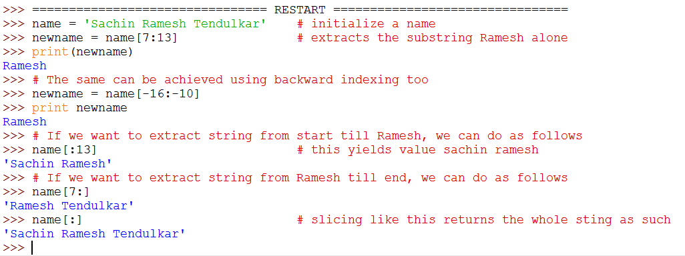
Illustration

Slide 12
Input and output
Now look at some ways in which we can print data on screen.
Using .format → an inbuilt string function.
String formatting.
Converting everything to string and printing.
Now look at few examples that helps us to realize which of these is the best way.

Slide 13
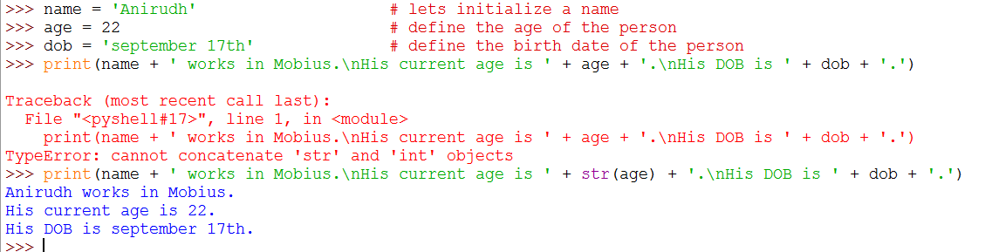
Illustration using concatenation of strings

Slide 14
Printing by concatenation
Here we see that an error is thrown at first, this is because ‘+’ for concatenation works on string only.
The ‘age’ variable is of int type, so we need to type cast the int object to a string.
Also printing by this way seems tedious, so its better to avoid this way.
Printing this is can also be referred as a poor form of coding in Python.

Slide 15
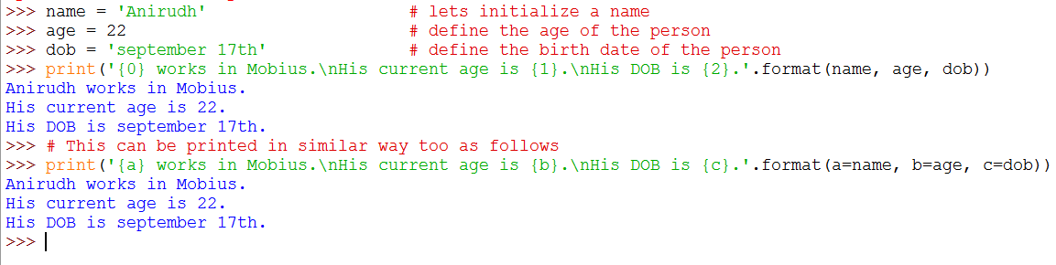
Illustration using .format

Slide 16
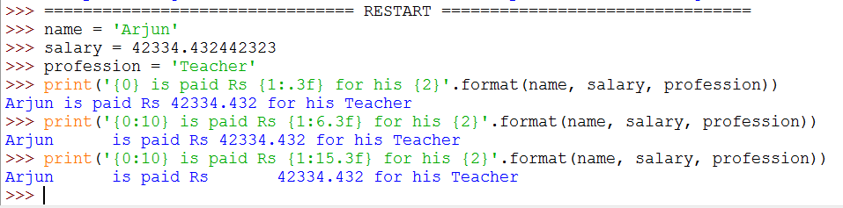

Slide 17
String formatting
This can be said to be the best form of printing.
I will discuss the basics of string formatting, you can learn on this from many Python sources on internet.
Printing using this way can be said to be efficient and a clean way.

Slide 18
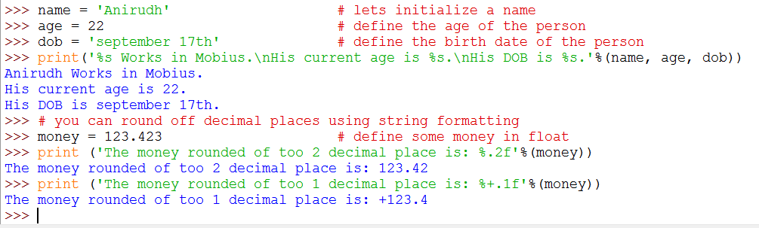
Illustration of string formatting

Slide 19
Trigger an input from user
In Python 2.7 there are two ways in which we can get input from user as follows:
input method.
raw_input method.
Lets look at the difference between these too as follows:

Slide 20
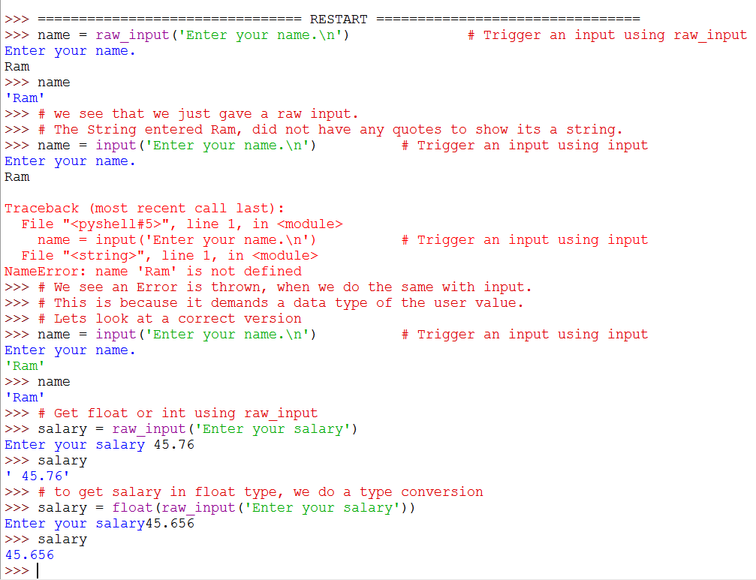
Illustration

Slide 21
Simple script
Now let us look at a simple script that will get the following input from user.
Name of circle: define a name for the circle.
Radius of circle: get the radius of circle.
Print the name of circle along with its area and circumference.

Slide 22
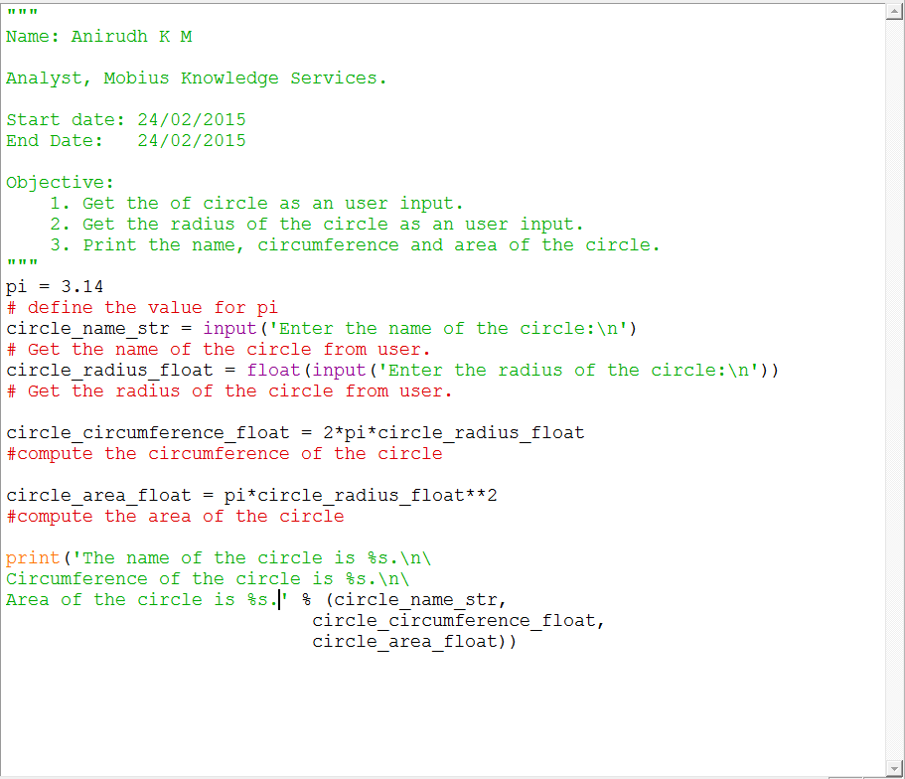
Script
Notes:
<number>

Slide 23
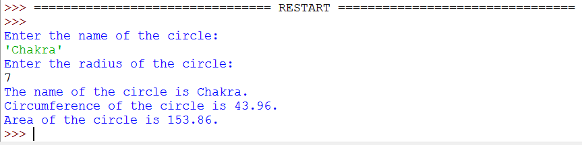
Output

